Slide 1
Week-06 Modern SPA Frameworks
Course Instructors:
Haris ahmed
DEPARTMENT OF SOFTWARE ENGINEERING
SIR SYED UNIVERSITY OF ENGINEERING & TECHNOLOGY

Slide 2
agenda
Defining SPA and MPA
SPA vs MPA: Defining Pros and Cons
SPA vs MPA: What to Choose?
Top JavaScript Frameworks
Frameworks measured by GitHub stars
Summary

Slide 3
What is Single-Page Application(SPA)?
A single-page application (SPA) is a web application or website that interacts with the user by dynamically rewriting the current web page with new data from the web server, instead of the default method of a web browser loading entire new pages.
The goal is faster transitions that make the website feel more like a native app.
Single-page applications try to imitate a natural environment in the browser. They do not require page reloads and extra wait time.
A SPA is just one web page that loads all other content using JavaScript. SPA requests data independently and renders pages straight in the browser.
Google Drive, YouTube, Spotify, Web Facebook

Slide 4
What is a Multi-Page Application(MPA)?
A multiple-page app works in a traditional way where every change displays the data or submits data back to server requests rendering a new page from the server in the browser.
Such solutions are bigger than single-page applications. These apps have many levels of UI because of the amount of content. Amazon or eBay are great examples, as well as other complex sites with multiple pages.
Amzon , blogs

Slide 5
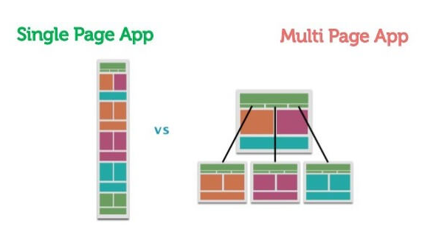
Single Page App vs Multi Page App

Slide 6
Single Page App vs Multi Page App
# | Advantage | Explanation
1 | Fast & Smooth | After first load, only content changes — no full page reload. Feels like a mobile app.
2 | Better User Experience | No white screen flash between clicks. Transitions are smooth.
3 | Caches Data Well | Once loaded, many assets stay in browser memory. Works offline possible.
4 | Less Server Load | Server sends data (JSON), not full HTML pages. Less bandwidth usage.
5 | Easy to Make Mobile App | Same code can be converted to Android/iOS app using tools like React Native.
6 | Faster Navigation | Back/forward buttons work instantly without reloading the page.

Slide 7
SPA vs MPA: Defining Pros
SPA
Ability to reuse code.
The process of development is simple and friendly: no need to write code to render pages on the server.
SPAs work fast, as most resources are only loaded once throughout the lifespan of the app.
SPAs are easy to debug with Chrome.
Ability to work offline.
MPA
Multi-page apps may include as much product info as required, with no page restrictions.
Faster initial page load.
They provide a visual map of where to go with clear menu navigation.
MPAs provide lots of analytics and data about how a website works.
MPA development is a cost-effective approach.

Slide 8
MPA
# | Advantage | Explanation
1 | Better for SEO | Search engines (Google) can easily index each page. Good for blogs, e-commerce.
2 | Simpler Development | No complex JavaScript frameworks needed. Traditional HTML/CSS works fine.
3 | Works Without JavaScript | Even if user disables JS, pages still work. More accessible.
4 | Clear Page Structure | Each page has its own URL. Users understand exactly where they are.
5 | Lower Memory Usage | Browser doesn't keep everything in memory. Pages load fresh each time.
6 | Good for Large Data | If website has thousands of pages (like Amazon, Wikipedia), MPA handles it better.

Slide 9
SPA Defining cons
Disadvantage | Explanation
1 | Slow First Load | All JavaScript loads at once on first visit. On slow internet, user waits 10-15 seconds with a blank screen.
2 | Bad for SEO | Search engines (Google) cannot easily index SPA pages. Not good for blogs or e-commerce websites.
3 | No JavaScript = No Website | If user disables JavaScript in browser, SPA shows nothing. Just a white blank page.
4 | Broken Back/Forward Button | Browser back and forward buttons often don't work properly. User gets confused where they are.

Slide 10
MPA Defining cons
# | Disadvantage | Explanation
1 | Slow Page Transitions | Every click loads a whole new page. User waits 1-2 seconds for each page. Feels slow and annoying.
2 | Heavy Server Load | Server has to send a new HTML page for every request. More users = more server pressure.
3 | Hard Mobile Development | Cannot reuse same backend code for mobile app. Have to write separate code for web and mobile.
4 | Difficult Maintenance | If website has 100 pages and you want to change the menu, you must update all 100 pages.
5 | Poor User Experience | Page reloads every time. No smooth animations. Feels old and clunky like 2000s websites.
6 | More Bandwidth Usage | Each page reload downloads HTML, CSS, JS again. Wastes user's mobile data.

Slide 11
SPA vs MPA: Defining cons
SPA
Not friendly navigation.
Disabled JS can hinder the proper functioning of the application.
Security threat during SPAs development because of the cross-site scripting.
Space constraints.
MPA
Performance speed decreases.
Loading time increases.
Mobile development is not easy because you cannot use the same backend code.
Maintaining security may become a challenge, as developers have to secure each separate page.

Slide 12
SPA vs MPA: What to Choose?
Let’s briefly explore the key characteristics of the SPA and MPA approaches.
SPEED
Speed is an essential factor in this context. People get more and more impatient, and their attention spans are getting shorter.
Single-page applications load faster because the majority of app resources are loaded just once. When a new piece of data is requested by the user, the page doesn’t reload entirely.
A multiple-page app is slower as the browser must reload the entire page from scratch every time the user wants to access new data or moves to a different website’s part.
If the app or website is image-heavy then choosing a SPA is a safer option.

Slide 13
SPA vs MPA: What to Choose?
USER EXPERIENCE
Any SPA looks more mobile-friendly. You should care about this fact, as a lot of traffic comes from mobile devices. Frameworks applied in single-page app development enable you to develop mobile apps.
On another hand, an MPA enables better information architecture. You can create as many pages as required, including as much information on a page as you need with no limits. Users can easily find their way around the website thanks to the clear navigation. It positively impacts their experience.

Slide 14
SPA vs MPA: What to Choose?
DEVELOPMENT PROCESS
The reusable backend code is one of the greatest benefits of single-page applications. And reusable code requires less work. It is possible to apply the same code you used in your web app to your native mobile application.
Due to clear division between front-end and back-end, both parts can be developed simultaneously. It accelerates the entire development process. MPA’s require more time because in most cases, the server-side has to be coded from the beginning.

Slide 15
SPA vs MPA: What to Choose?
COUPLING
In SPAs, front-end and back-end are separate. Such applications use APIs developed by server-side developers for reading and displaying data.
Front-end and back-end in MPAs are more interdependent meaning that all coding is usually housed under one project.
SECURITY
The larger the website the more effort it takes to secure it. Choosing MPAs, you will have to secure every webpage. In SPA, all you need to keep your page safe is secure data endpoints that look much faster but not necessarily safer. Besides, SPAs are more prone to hacker attacks.

Slide 16
Top JavaScript Frameworks
Frameworks are more adaptable for the designing of websites, and hence, most website developers prefer them. JavaScript frameworks are a type of tool that makes working with JavaScript easier and smoother. These frameworks also make it possible for the programmer to code the application as a device responsive. This responsiveness is yet another reason why the JavaScript frameworks are quite popular when it comes to the question of using a high-level machine language.

Slide 17
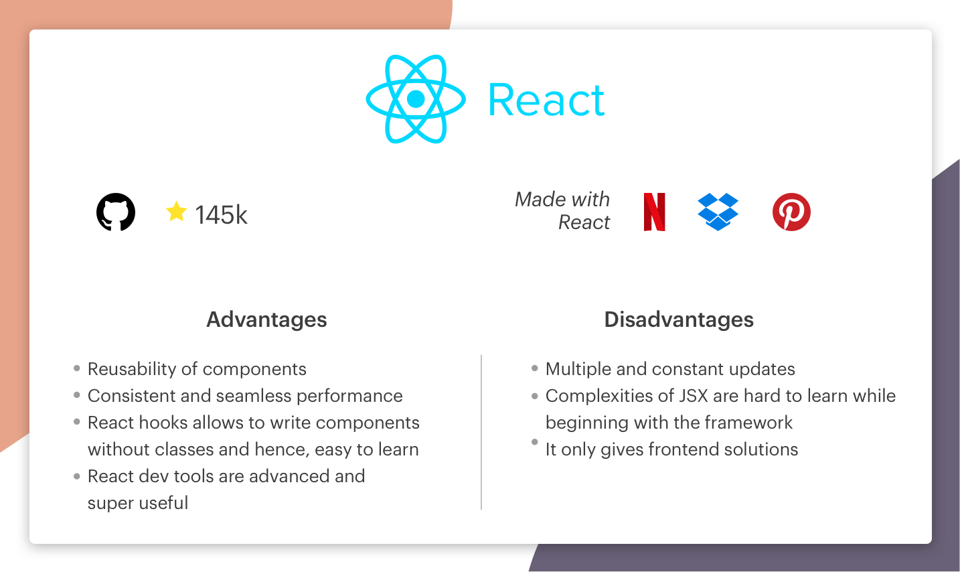
#1 React

Slide 18
Contd…
Fast performance and smooth UI updates Component-based structure for reusable code Highly flexible and easy to customize Large job opportunities in the market Strong community support and resources Used in many real-world and large applications Developed by Meta
React is a JavaScript library used to build user interfaces (UI) for web applications.
It focuses only on the view (frontend UI).
It is flexible, meaning developers choose their own tools for routing, state management, etc.
It is fast and component-based.
Created by Meta

Slide 19
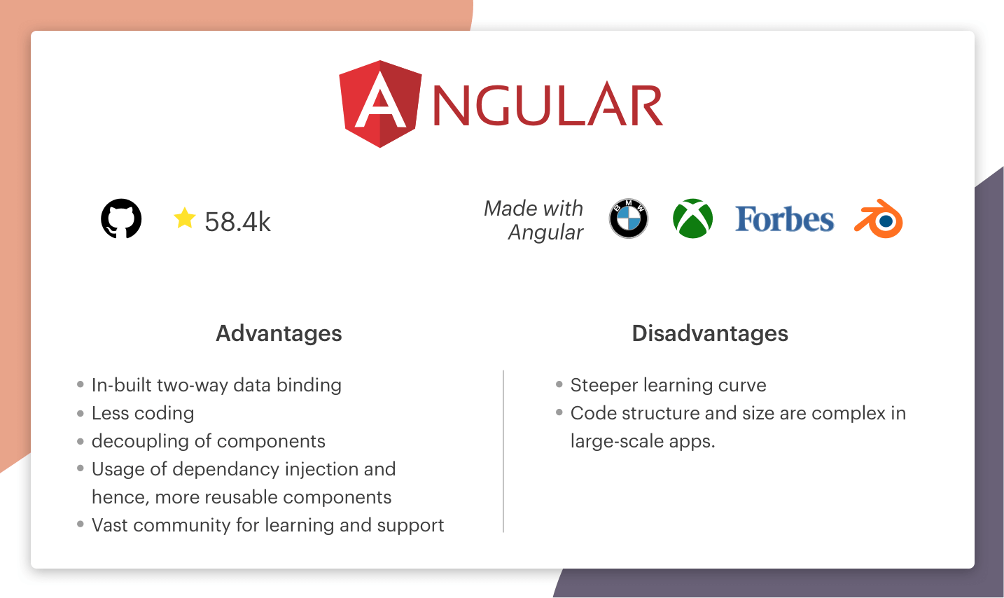
#2 Angular

Slide 20
Contd…
Angular is a full-featured JavaScript framework used to build large-scale web applications.
It provides a complete package (routing, forms, HTTP, etc. are built-in).
It follows a strict structure and rules.
It is more powerful but complex for beginners.
Created by Google

Slide 21
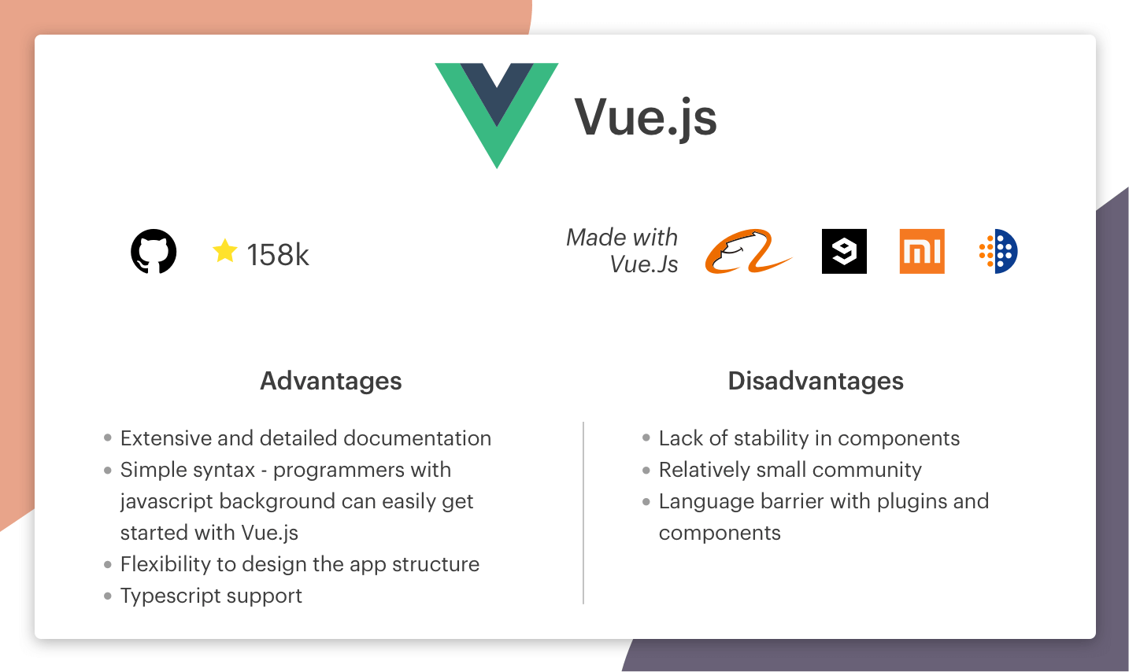
#3 Vue.js

Slide 22
Contd…
Easy to learn
Lightweight and fast
Flexible structure
You can use it step by step in any project
Good for small and medium apps
Developed by Evan You

Slide 23
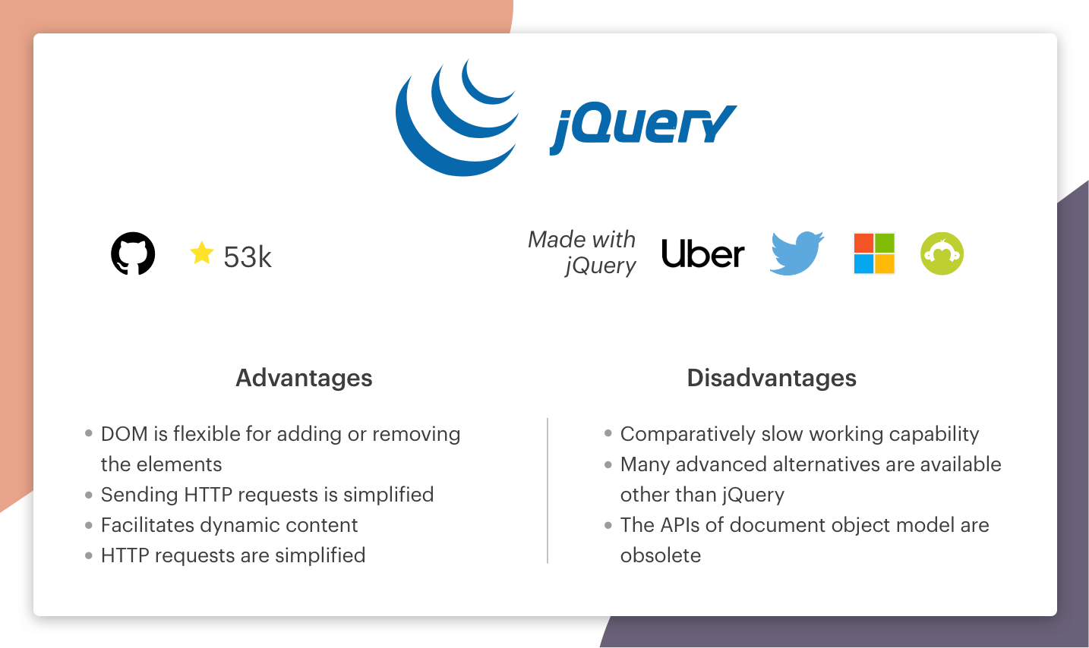
#4 jQuery

Slide 24
Contd…
When to use jQuery :
jQuery is used in developing desktop-based JavaScript applications. The framework keeps the code concise and pretty simple. It is used in handling the events and performing animations.
When not to use jQuery :
When you are developing a large scale application, it is not possible to use jQuery because it makes your application heavy by putting a lot of extra JavaScript code. The framework is not capable of competing with the modern frameworks with advanced facilitation of JavaScript, less coding, and reusability of components.

Slide 25
summary
A single-page application is a solution that performs inside a browser and does not require page reloading during its use. Unsurprisingly, you are using this type of apps daily.
In a SPA, a page refresh never occurs; instead, all necessary HTML, JavaScript, and CSS code is either retrieved by the browser with a single page load, or the appropriate resources are dynamically loaded and added to the page as necessary, usually in response to user actions.
The State of JavaScript 2019 concludes that React, and Vue are most popular among developers, which makes them the top two frontend frameworks of 2021 as well.

